Slide 1
Building Strategic Relationships with Other Consultants Chemical Consultants Network
Charles Dormer
10th October 2018
Notes:
Introduction
Show of hands
Who has been involved in a strategic partnership with other consultants or providers?
Other consultants where you have led project?
Where the other consultants have led partnership?
Do you have strategic partnership with suppliers of services, -accountant., sales and marketing, website designers, etc.?

Slide 2
Building Strategic Relationships with Other Consultants - Overview
Client environment changed and is changing
We need innovative business models to meet changing needs
One idea strategic relationships
What do we mean by strategic partnerships?
Reasons for entering partnerships
Managing the relationship
Exiting the relationship
Notes:
Unprecedented
VUCA – Volatile, Uncertainty, Complexity, Ambiguity
Technology moving very quickly – science fiction changing traditional businesses
Big data – new sources of customer data
Connectivity
Shifting demographics
Digital generation and millenials see the world differently. Digital natives after 1996 have never lived without the internet
Clients have unprecedented access to you and your competition – more difficult to stand out as an expert
Pressure on clients to be agile in their strategy, structure, processes, people and technology toward value creating and value protecting opportunities

Slide 3
Client Environment has Changed and is Changing
Unprecedented Change
VUCA
Technology moving very quickly – science fiction changing traditional businesses
Big data – new sources of customer data
Connectivity
Shifting demographics
Unprecedented access to you and your competition
Pressure on clients to be agile
Are you seeing this with your clients?
Notes:
Unprecedented
VUCA – Volatile, Uncertainty, Complexity, Ambiguity
Technology moving very quickly – science fiction changing traditional businesses
Big data – new sources of customer data
Connectivity
Shifting demographics
Digital generation and millenials see the world differently. Digital natives after 1996 have never lived without the internet
Clients have unprecedented access to you and your competition – more difficult to stand out as an expert
Pressure on clients to be agile in their strategy, structure, processes, people and technology toward value creating and value protecting opportunities

Slide 4
What have we learned about our clients and their perspective?
More selective and modular – small well-defined scopes of work
Innovative solutions
Smaller newcomers – speed and flexibility
Co-create with client
Connected through platforms
Knowledge and Wisdom – Consulting and Coaching
Demonstrate ROI
Content over process
We need Innovative business models to meet changing client needs…

Slide 5
We need innovative business models to meet changing client needs…
Consulting today require business models that are flexible
One solution is to build strategic relationships with other consultants
5

Slide 6
What do we mean by Strategic Relationships?
Two or more organizations working together to solve a problem
Collaboration – equal power in the relationship
Supplier relationship
Strategic alliance
Joint venture
? others
6

Slide 7
There is a lot out there about strategic partnerships……
If you Google Strategic partnerships (7m hits)
Benefits 5m
Small Business 3.6m
Consultants 2.4m
Coaching 2m
Leadership 7.3m
Failure 3.6m
Success stories 4.3m
ROI 1.0m
Jobs 8.6m
To put it in perspective
Leadership 779m
Coaching 449m
Mindfulness 45.5m
Taylor Swift 73m

Slide 8
It can get complicated
Organizations of different sizes (large and small)
Different types of organizations (academia, public and private)
Different motivations and agendas
Co-creative innovation (creating something new)
Nature of the work (innovative, etc.)
Multiple partners
Speed of decision making
Organizational politics
Legal complexity
Ability to resolve conflict

Slide 9
What are some issues and best practices that you can share?
Reasons for entering partnerships
Choosing the right partner
Forming the relationship
Managing the relationship
Exiting the relationship
9

Slide 10
Reasons for Entering Partnership
What are the reasons you entered into a strategic relationship with another consultant or consultant group?
10

Slide 11
Reasons for Entering Partnership
What are the reasons you entered into a strategic relationship with another consultant or consultant group?
Credibility
Complementary Expertise
Additional Contacts
Sharing business risk
Opening to new markets
Increase capacity
Deal with multiple requests from client and change of scope
Add diverse and creative thinking (two heads better than one)
Access to thought leadership
Perceived size of company
Brand evolution
Opening contracts and opportunities that need additional certifications, etc.
11

Slide 12
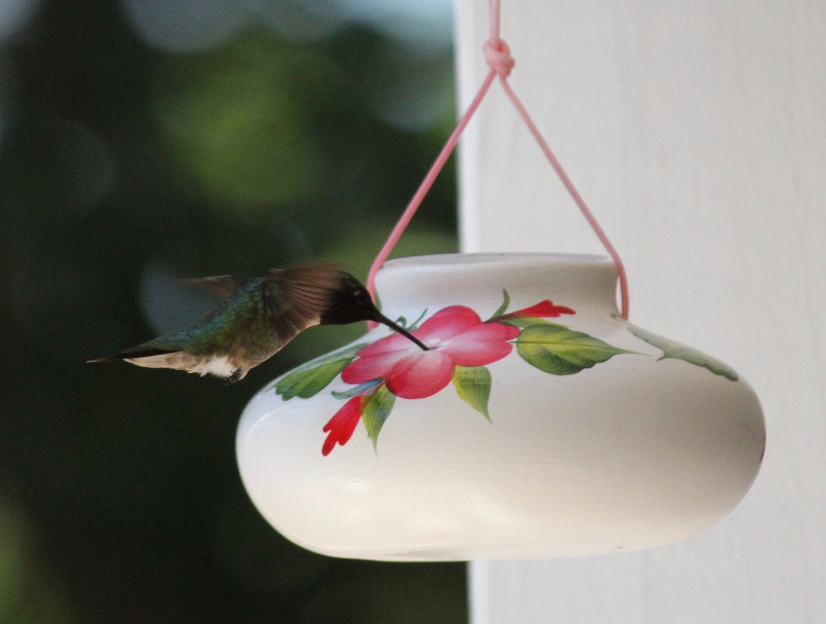
Choosing the Right Partner
How did you identify the right partner and make the decision to work with them?
What were some of the qualities you looked for in a partner?
12

Slide 13
Choosing the Right Partner
How did you identify the right partner and make the decision to work with them?
What were some of the qualities you looked for in a partner?
Good fit – usually get a “gut” feeling if you can trust that person
Good communication
Understand their world view
Good fit with potential clients
References from past work
Exploratory discussions including how do they deal with a client in crisis situation?
See examples of their product and assess quality
Due dilligence of company background, etc.
Identify good cultural fit and shared values
IMC-USA Code of Ethics
Set up a trial project so you can see how they really work
Shared thinking, however, sometimes need a different point of view
If relationship is to be truly strategic – need to vet the relationship for 6 months – try them out
13

Slide 14
Forming the Relationship
How did you approach the potential partner and negotiate terms and conditions?
14

Slide 15
How did you approach the potential partner and negotiate terms and conditions?
Put something in writing – contract
Clear scope of work
What success looks like
Who owns product and IP – intellectual and capital
Confidentiality
Conflict of interests
Terms – who gets paid what and when
Termination, etc. – Consider exit strategy
Be clear about the independence of the parties – be willing to lose some control
Be clear about any restrictions on work in the future
Negotiate what each party believes is fair
Be willing to walk away if necessary
Contract on a trial basis (6-months to 1 Year) – try out relationship on a short term project
15

Slide 16
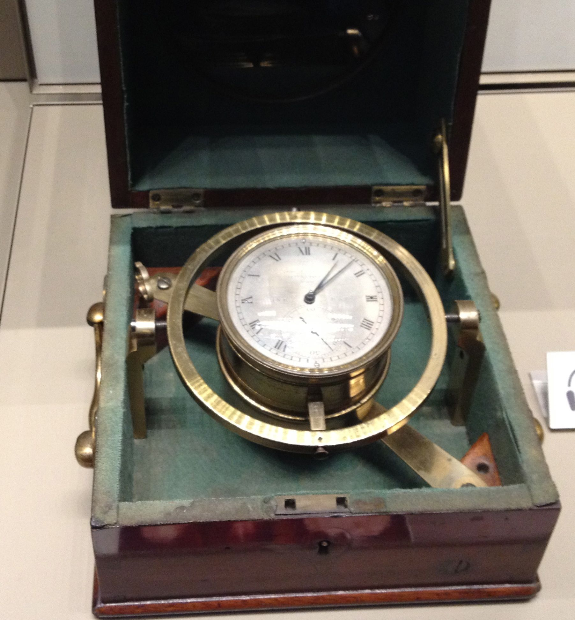
Managing the Relationship
What are some of the pitfalls you encountered in forming the relationship?
Once the relationship was formed what were some of the best practices you saw that helped to make the relationship successful?
What were the lessons learned when the relationship was not successful?
16

Slide 17
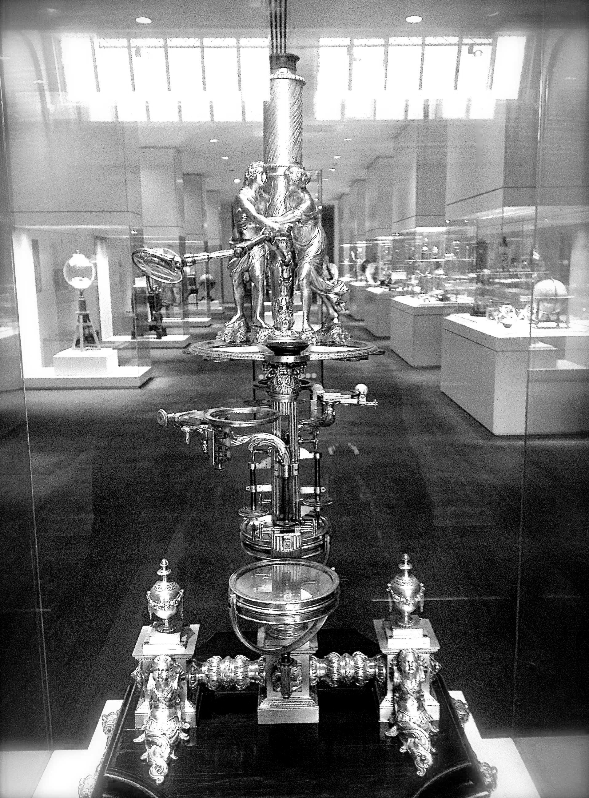
My research identified two dimensions….
Task and Delivery factors
Trust and Relationships
Let’s consider those factors…….

Slide 18
Critical Success Factors
Task and Delivery Factors “Hardware” (TD)
Reasons for entering the alliance (RA)
Identification of the right partner (RP)
Potential synergies in the collaboration (PS)
Driving to outcome and deliverables (DO)
Alliance structure, planning and governance (AS)
Trust and Relationship Factors “Software” (TR)
Organizational differences (OD)
Chemistry between partners (CP)
Working together to collaborate (WT)
Alliance leadership (AL)
Communication and Collaborative Technologies (CT)

Slide 19
Partnerships and Collaborations can take several forms…
C
100
Unproductive Friendship | Transformational Co-Creative Collaboration
Fruitless Liasons | Transactional Partnership
75
Trust &
Relationship
Factors (TR)
0
0
75
100
Task and Delivery Factors (TD)

Slide 20
Model – Successful Alliances in Biotechnology
Success
Vision
Resources and Technology
Decision-making
Trust
Adaptability
Dormer and Thomas Esseau 2017
Notes:
Peter Zak Model
Ovation – 61%
Expectation – 72%
Yield – 57%
Transfer – 54%
Openness – 63%
Caring – 45%
Invest – 49%
Natural – 46%
Lojeski
VD associated with:
90% drop in innovation
83% decrease in trust
80% drop in job satisfaction and employee engagement
65% decrease in clarity
60% decline in on-time and on budget performance
50% hit in leaders effectiveness

Slide 21
The Neuroscience of Trust
Employee in high-trust organizations are:
More productive (50% higher)
have more energy at work (106% more)
collaborate better with colleagues
stay with their employer longer
suffer less stress (74% less)
happier with their lives (29% more)
fewer sick days (13% less)
more engaged (76% more)
Less burn out (40% less)
Paul Zak – HBR January-
February 2017

Slide 22
How to Manage for Trust
Recognize excellence
Immediately after goal met
Comes from peers
Tangible, unexpected, personal and public
Induce “challenge stress”
Difficult but achievable
Concrete endpoints
Check in frequently to assess progress and adjust if too easy or out of reach
Give people discretion in how they do their work
Autonomy promotes innovation
Oversight and risk management help minimize negative deviations
Enable job craft
Trust employees to choose projects
People focus energy on what they care about
Paul Zak – HBR January-
February 2017

Slide 23
How to Manage for Trust
Share information broadly
Uncertainty about company’s direction leads to chronic stress
Intentionally build relationships
Often get message to focus on completing tasks, not on making friends
When people intentionally build social ties at work – performance improves
Facilitate whole person growth
Develop personally as well as professionally
Growth mindset
Show vulnerability
Ask for help – not just telling them to do things
Paul Zak – HBR January-
February 2017

Slide 24
How to Manage for Trust
I would add the following:
Be consistently open and honest in your interactions
Be willing to make commitments and live up to them
We have discussed some leadership styles that add to building trust
Be willing to actively listen and learn – have a growth mindset
Be empathetic to others and be self-aware
Be vulnerable and ask for help
Be present and authentic
Be open to giving and receiving feedback
Paul Zak – HBR January-
February 2017

Slide 25
Building Trust
What are some of the characteristics you look for in a partner that builds trust?
Sharing fresh insights
Insight tools (Myers Briggs, etc.)
Anticipate problems
No surprises
Owning mistakes
Delighting the customer
Be predictable
Active listening
Willing to understand others point of view
Demonstrate advocacy for others
Be a learner
Demonstrate trust behaviors (Covey- Speed of trust)
What are some of the ways to build trust?
Communication – face to face at least in the first instance
Live up to commitments and follow-up
Transparency
Give back
Be consistent in actions and product delivery
Give feedback
Re-evaluate relationship regularly – learning
Trust involves taking risk and managing that risk
Manage ego energy
Share values
25

Slide 26
Effective Leaders in a Co-creative collaborations need to…
Clearly define and communicate a strategy, purpose and vision for the alliance
Assess and select a partner with the right technical expertise, resources and experience
Recognize the technical strengths of partners and how they complement each other and are aligned
Have the ability to drive outcomes (creativity) going beyond the agreement that benefit partners with growth opportunities
Manage the alliance (conflict management, project and alliance management)
Build trust in partnership through influencing skills and courageous leadership (team and stakeholders)
Create the optimal culture within partnership by understanding and appreciating cultural differences and diversity
Manage the team dynamics and create an environment so that everyone can be “in flow”
Create a collaboration that can learn from successes and failures, share ideas and be creative
Manage communication and collaborative technologies to ensure clarity and understanding and shorten virtual distance between partners (physical and organizational)

Slide 27
Exiting the Relationship
What are best practices you have seen in exiting or terminating the relationship?
27

Slide 28
For more information please contact Charles Dormer APEX STP, LLC Charles.Dormer@Apexstp.com Website: APEXSTP.com Phone: 484-942-6818 LinkedIn profile : https://www.linkedin.com/in/charlesdormer Check out blog - Leadership in the World of Co-Creative, Decentralized Complex Networks (please like) https://www.linkedin.com/pulse/leadership-world-co-creative-decentralized-complex-networks-dormer?trk=mp-author-card
Notes:
Introduction
Show of hands
Who has been involved in a strategic partnership with other consultants or providers?
Other consultants where you have led project?
Where the other consultants have led partnership?
Do you have strategic partnership with suppliers of services, -accountant., sales and marketing, website designers, etc.?

